Slide 1
Information polymer databases
Brief presentation of Pfam and UniProt (proteins)
and Rfam (RNA)

Slide 2
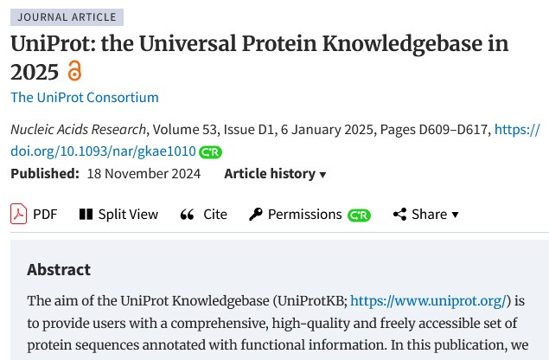
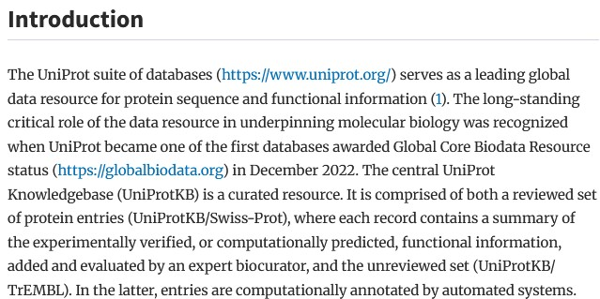
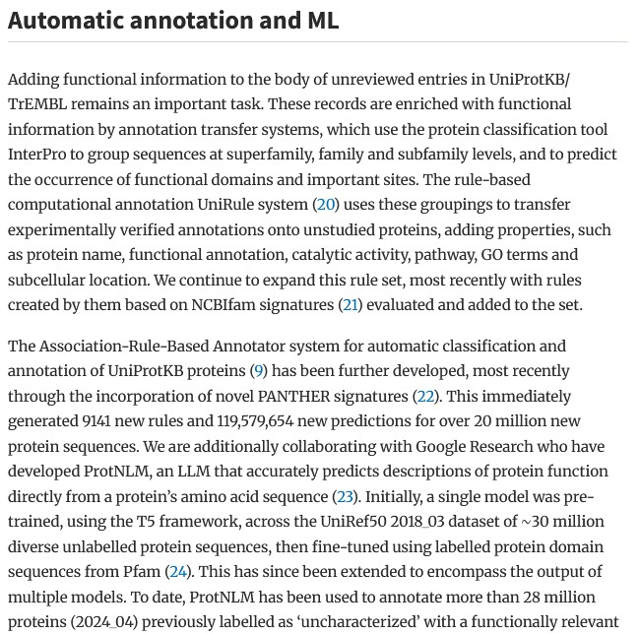

Slide 3
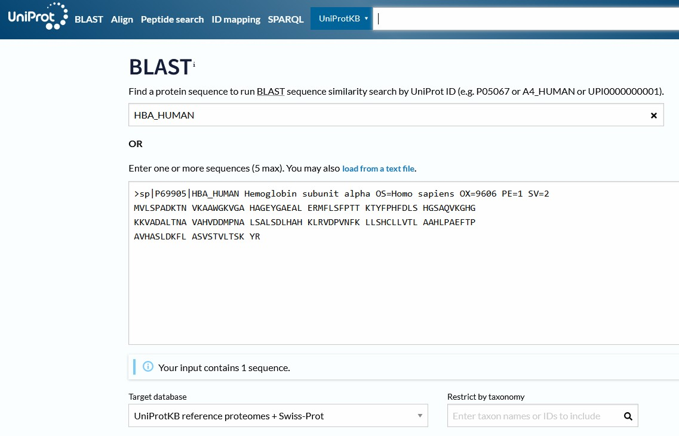
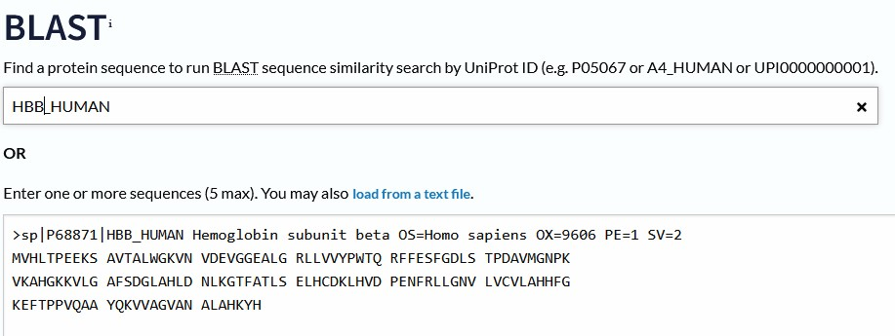

Slide 4

P69905 Hemoglobin subunit α (UnitProt HBA_HUMAN)
1 MVLSPADKTN VKAAWGKVGA HAGEYGAEAL ERMFLSFPTT KTYFPHFDLS H
52 GSAQVKGHG KKVADALTNA VAHVDDMPNL SALSDLHAHK L
92 RVDPVNFK LLSHCLLVTL AAHLPAEFTP AVHASLDKFL ASVSTVLTSK YR (L=132)
P68871 Hemoglobin subunit β (UnitProt HBB_HUMAN)
1 MVHLTPEEKS AVTALWGKVN VDEVGGEALG RLLVVYPWTQ RFFESFGDLS TPDAVM
57 GNPK VKAHGKKVLG AFSDGLAHLD NLKGTFATLS ELHCDKL
98 HVDPENFRLLGNVLVCVLAHHFGKEFTPPVQAAYQKVVAGVANALAHKYH
Alignment of the central part (ℓ=41) of the two proteins using BLOSUM50 substitution matrix (from [Durbin], §2.1)

Slide 5
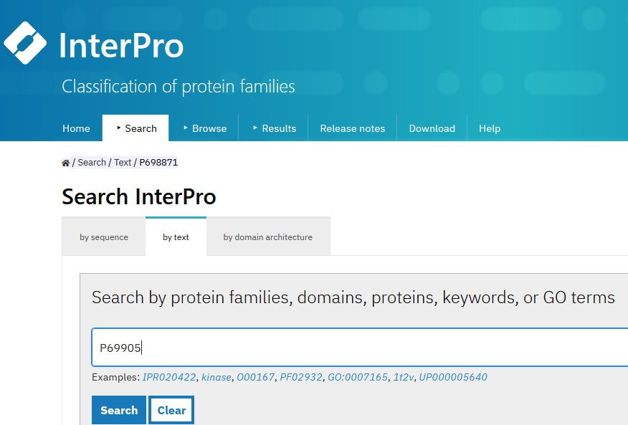
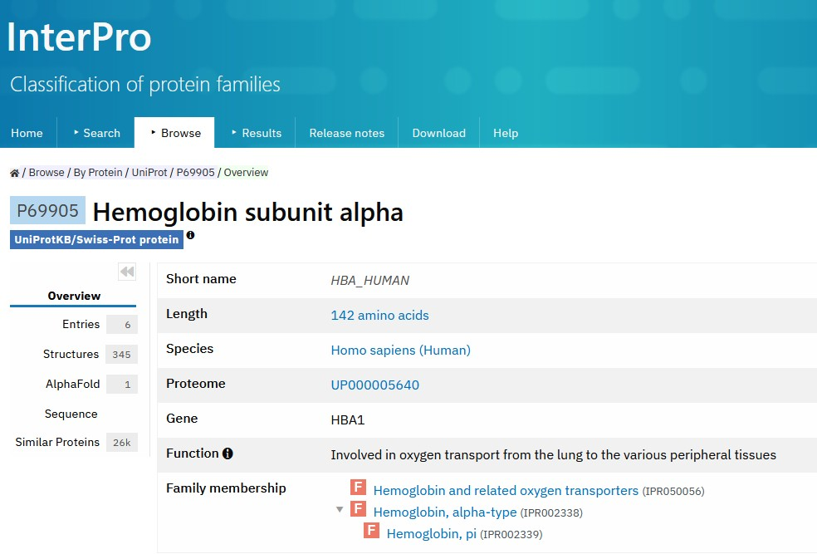
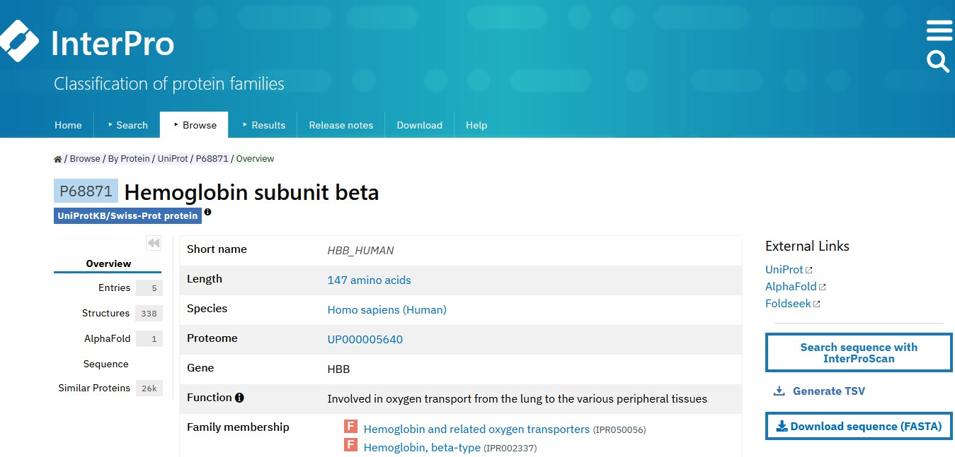

Slide 6
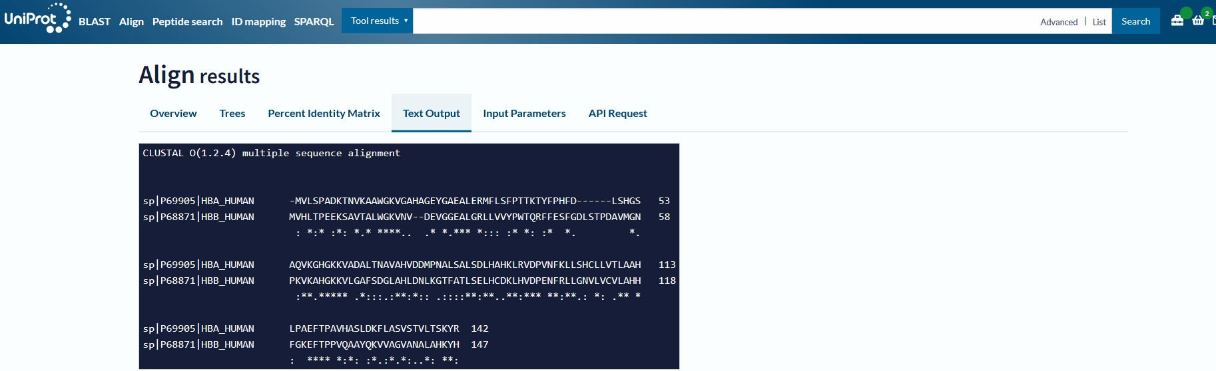
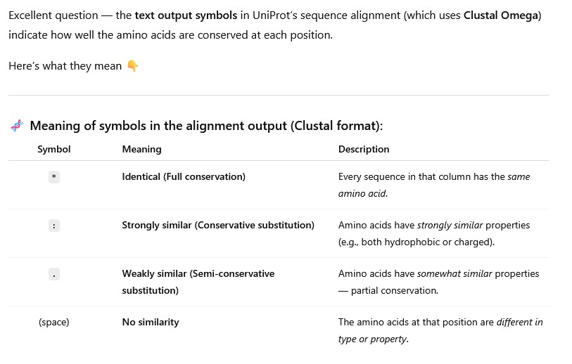
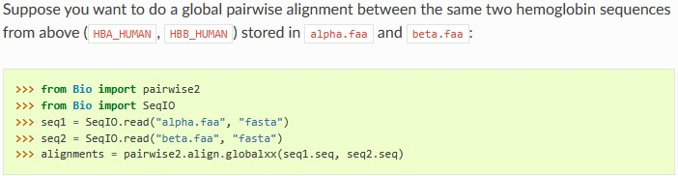


<pip install Biopython>
import Bio

Slide 7

Gapped alignment (from [Durbin], §2.1) of evolutionarily related alpha globin (HBA) and yellow lupin leghaemoglobin

