Slide 1
Cours de biostatistiques
Modélisation statistique des polymères informationnels
M2 IMSD 2025–26
J. Unterberger

Slide 2
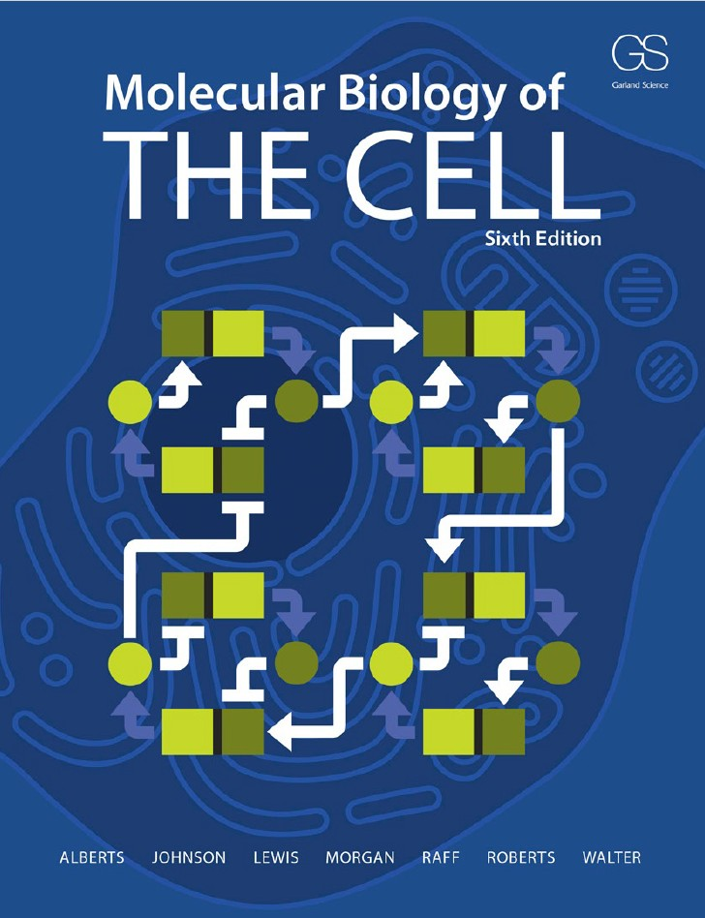
Les mathématiques pour la recherche fondamentale en biologie
Alberts, Morgan et al.
“To Understand Cells and Organisms Will Require Mathematics,
Computers, and Quantitative Information »
To progress from qualitative descriptions and intuitive reasoning to quantitative
descriptions and mathematical deduction is one of the biggest challenges for
contemporary cell biology. So far, the challenge has been met only for a few very
simple fragments of the machinery of living cells—subsystems involving a handful
of different proteins, or two or three cross–regulatory genes, where theory and
experiment go closely hand in hand
Knowledge and understanding bring the power to intervene—with humans,
to avoid or prevent disease; with plants, to create better crops; with bacteria, to
turn them to our own uses

Slide 3
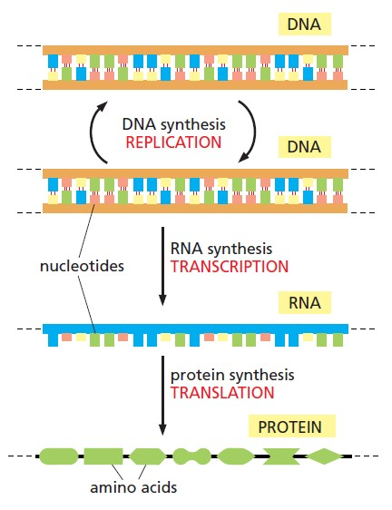
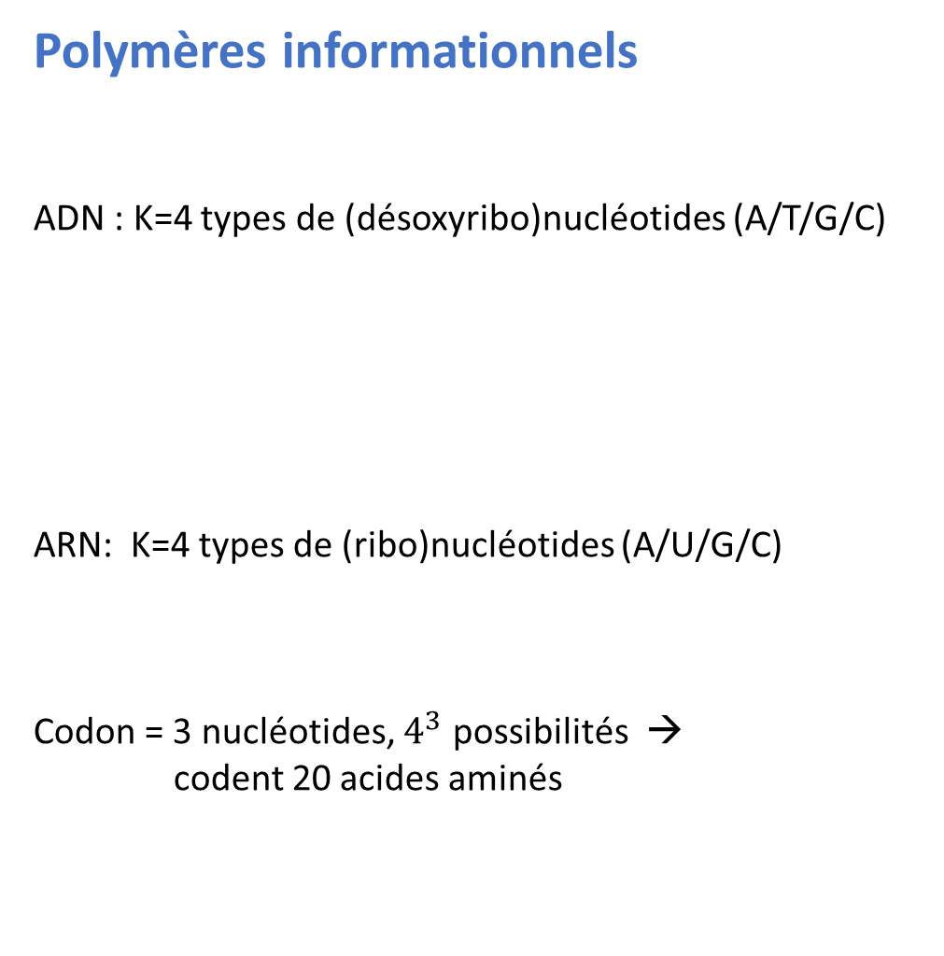
Polymères informationnels
ADN : K=4 types de (désoxyribo)nucléotides (A/T/G/C)
ARN: K=4 types de (ribo)nucléotides (A/U/G/C)
Codon = 3 nucléotides, $4^{3}$ possibilités →
codent 20 acides aminés

Slide 4
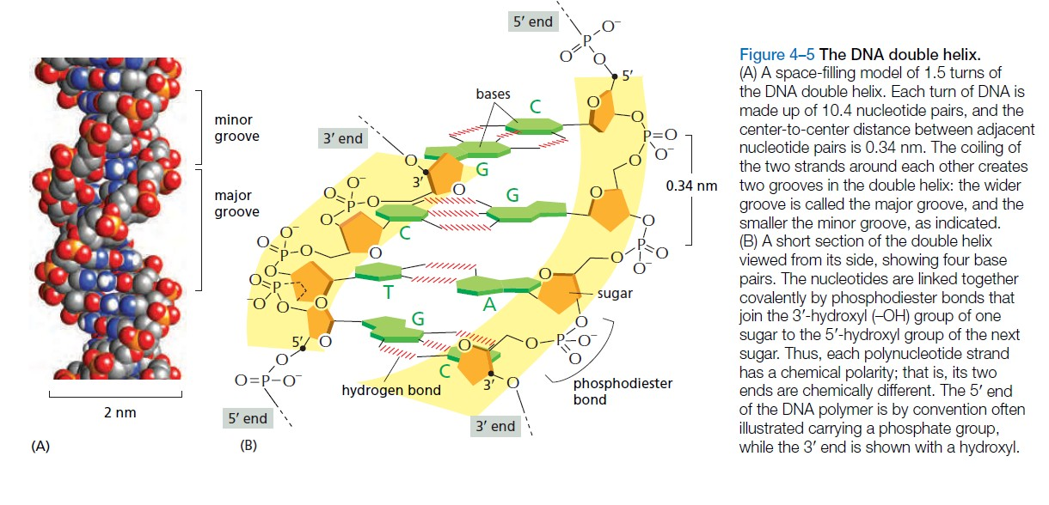
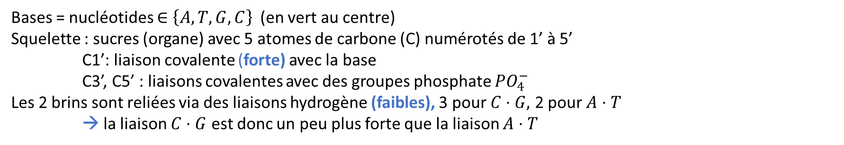
L’ADN est une double hélice (2 brins appariés par liaisons faibles)
Bases = nucléotides $∈\left\{A,T,G,C\right\}$(en vert au centre)
Squelette : sucres (organe) avec 5 atomes de carbone (C) numérotés de 1’ à 5’
C1’: liaison covalente (forte) avec la base
C3’, C5’ : liaisons covalentes avec des groupes phosphate $PO_{4}^{−}$
Les 2 brins sont reliées via des liaisons hydrogène (faibles), 3 pour $C⋅G,$ 2 pour $A⋅T$
→ la liaison $C⋅G$ est donc un peu plus forte que la liaison $A⋅T$

Slide 5
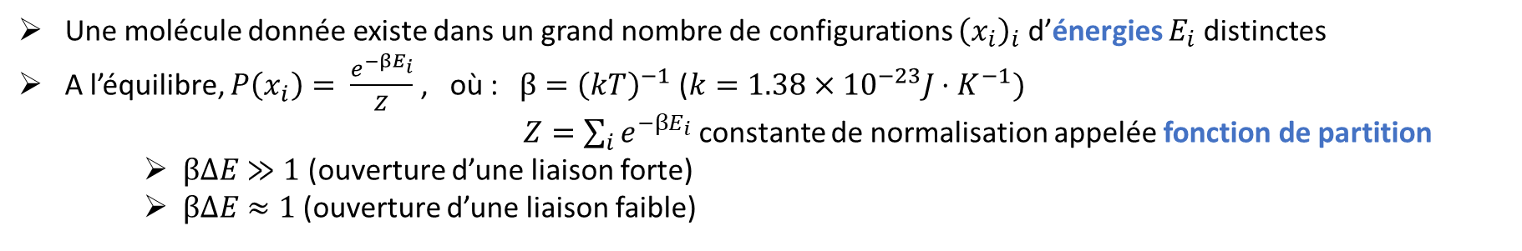
Les liaisons fortes sont incassables…
… en tout cas à température ambiante (25°C) ou même plus élevée, et en l’absence de réaction chimique avec d’autres molécules…
… mais pas les liaisons faibles…
… de légères fluctuations thermiques peuvent les détruire
En chauffant (50°C), on peut dénaturer l’ADN, c’est–à–dire ouvrir la double hélice, et détruire sa structure de repliement
Formalisme de la physique statistique à température T
Une molécule donnée existe dans un grand nombre de configurations ${\left(x_{i}\right)}_{i}$ d’énergies $E_{i}$distinctes
A l’équilibre, $P\left(x_{i}\right)= \frac{e^{−βE_{i}}}{Z}$ , où :$β={\left(kT\right)}^{−1}$ ($k=1.38×{10}^{−23}J⋅K^{−1})$
    $Z=\sum_{i}{e^{−βE_{i}}}$ constante de normalisation appelée fonction de partition
    $βΔE$ $≫1$ (ouverture d’une liaison forte)
    $βΔE$ $≈1$ (ouverture d’une liaison faible)
Cinétique aléatoire: chaîne de Markov réversible de mesure d’équilibre P (ex. Métropolis)

Slide 6
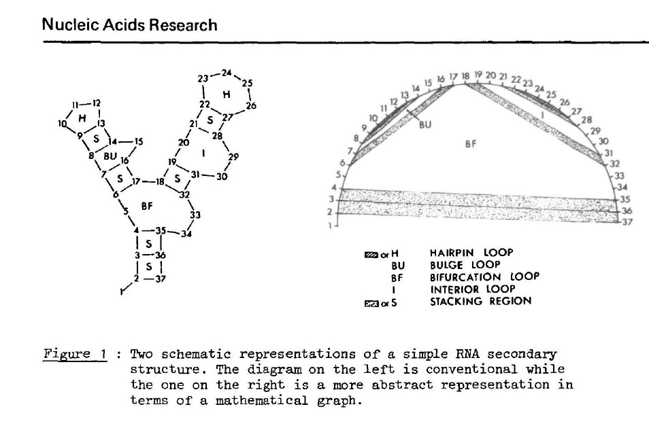
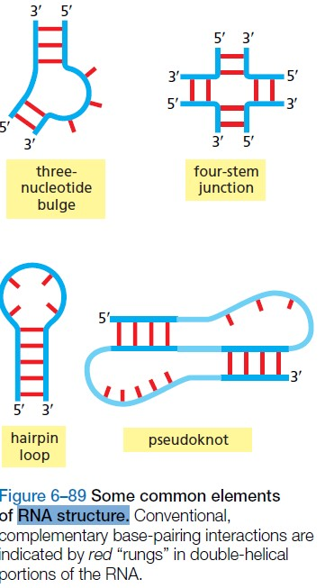
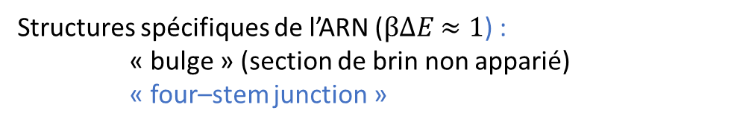
L’ARN est beaucoup plus flexible et réactif que l’ADN, et formé en principe de brins uniques
… la différence principale étant pourtant seulement la présence d’un groupe réactif –OH au lieu de –H sur C2’
… et l’absence d’un groupe –$CH_{3}$ (methyl) sur T (thymine) → U (uracil)
stem = tige
Structures spécifiques de l’ARN ($βΔE$ $≈1$) :
« bulge » (section de brin non apparié)
« four–stem junction »
hairpin = épingle à cheveux
Zuker & Stiegler, Nucleic Acids Research (1980)

Slide 7
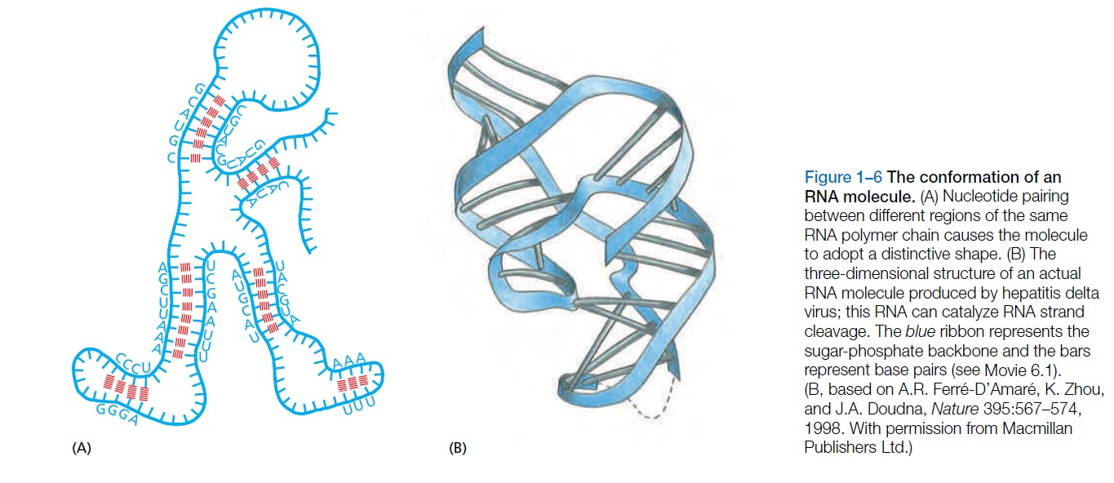
Structure secondaire de l’ARN
Appariements G–C, C–G, …
Quel est la structure d’appariement la plus stable ?
Structure développée 3D
Peut–on la prédire ?

Slide 8
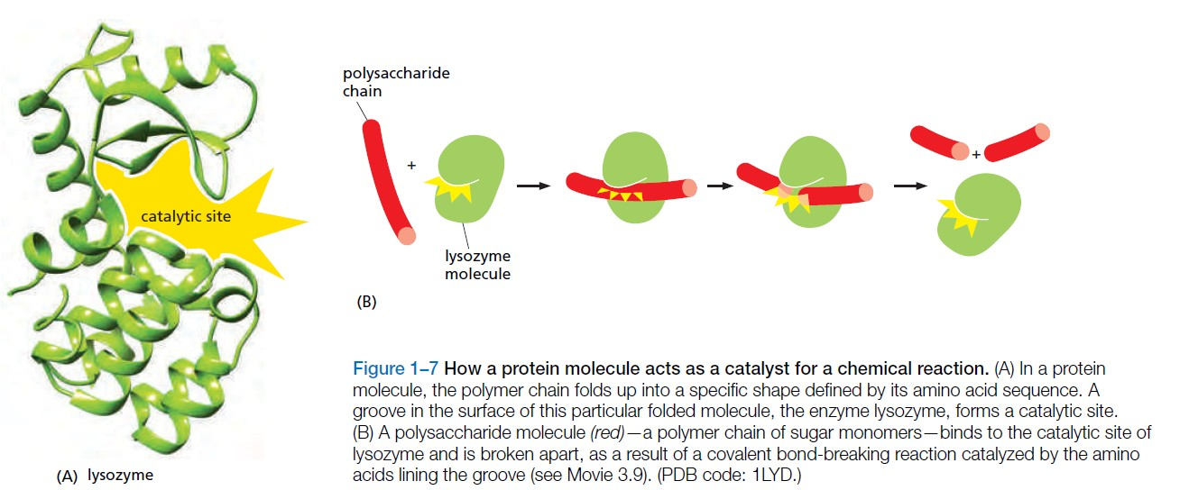
Les protéines servent de catalyseurs à toutes les réactions du vivant
Comment trouver la fonction à partir de la structure ?
Protein DataBase

Slide 9
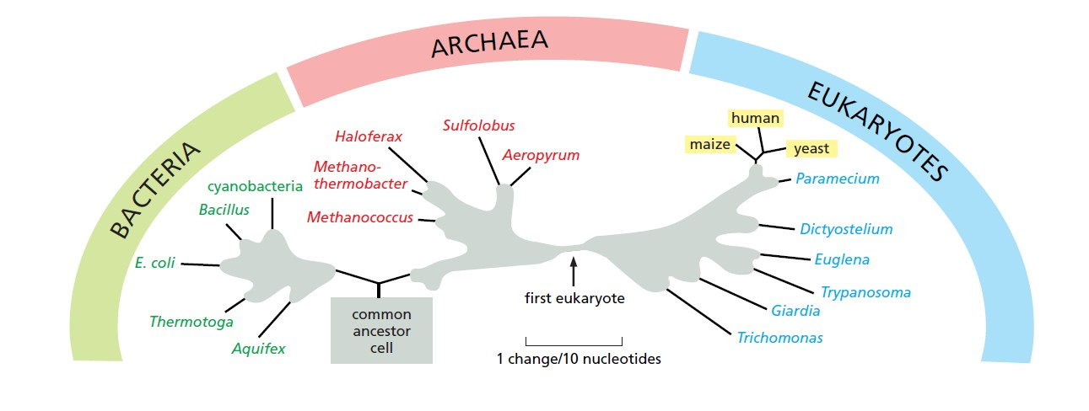
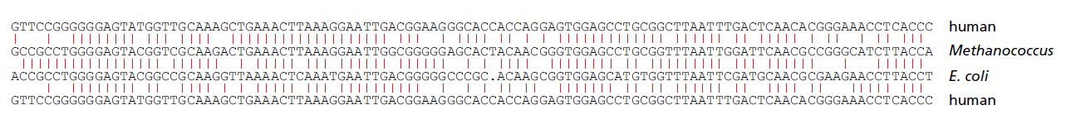
Evolution darwinienne
Phylogénie (structure d’arbre)
Séquences homologues
Genetic information conserved since the days of the last common ancestor of all living things.
A part of the gene for the smaller of the two main rRNA components of the ribosome is shown.

Slide 10
L’évolution est la toile de fond générale
Quelles sont les relations de dépendance statistique dans une famille de séquences homologues ?
Nécessité de comprendre les mécanismes évolutifs:
      Reproduction
      Sélection
      Mutation
Hypothèse générale: les mutations neutres dominent la toile de fond, quelques rares mutations avantageuses ayant un rôle clé dans la trajectoire générale de l’évolution
Les familles de séquences homologues données dans PFAM (Protein Families) ou RFAM (RNA Families) peuvent être considérés en première approximation comme des échantillons indépendants tirés d’une distribution
En réalité, les mécanismes évolutifs donnent les concepts clés

Slide 11
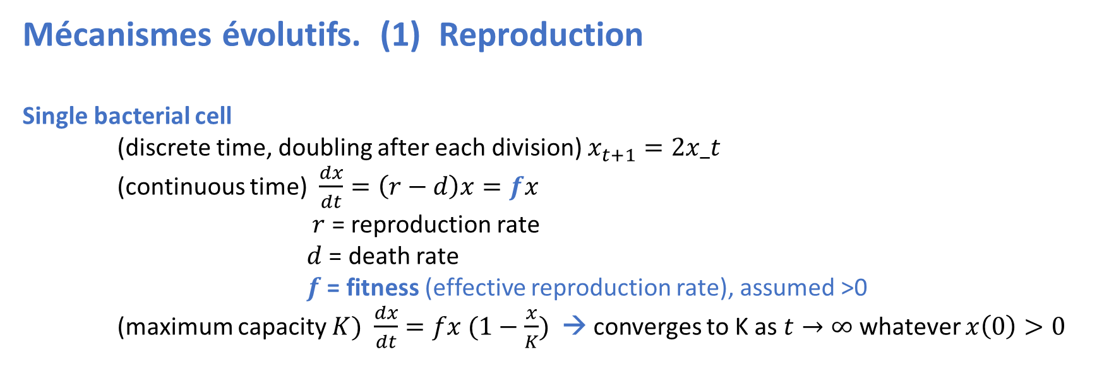
Mécanismes évolutifs. (1) Reproduction
Single bacterial cell
(discrete time, doubling after each division) $x_{t+1}=2x_t$
(continuous time) $\frac{dx}{dt}=\left(r−d\right)x=fx$
$r$ = reproduction rate
$d$ = death rate
$f$ = fitness (effective reproduction rate), assumed >0
(maximum capacity $K)$ $\frac{dx}{dt}=fx (1−\frac{x}{K})$ → converges to K as $t→∞$whatever $x\left(0\right)>0$

Slide 12
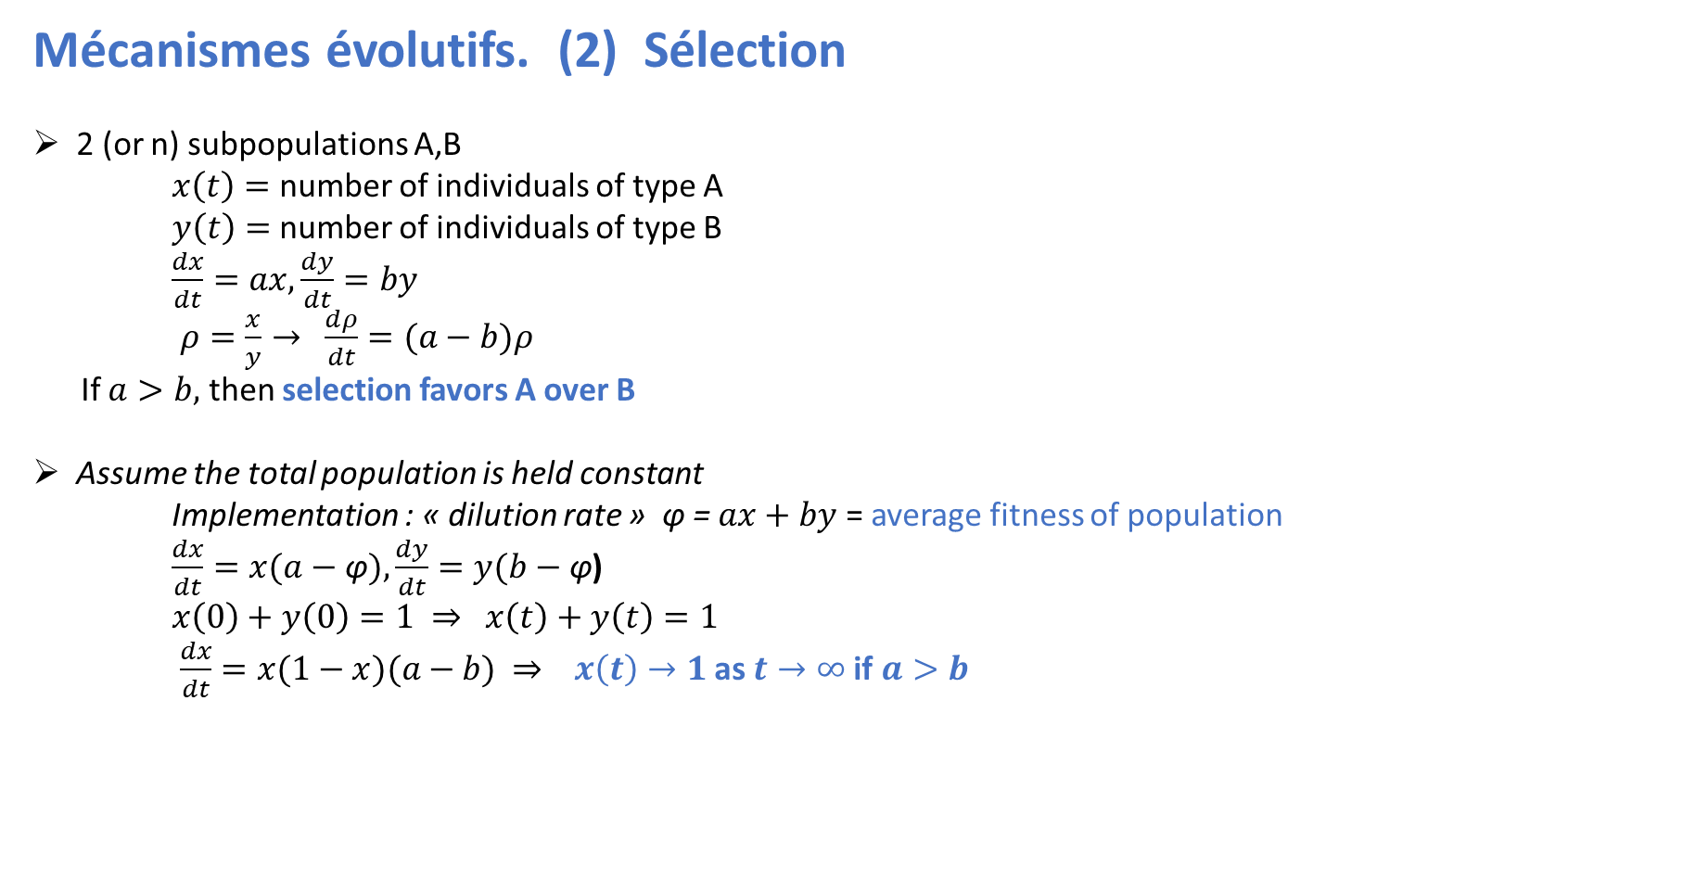
Mécanismes évolutifs. (2) Sélection
2 (or n) subpopulations A,B
$x\left(t\right)=$ number of individuals of type A
$y\left(t\right)=$ number of individuals of type B
$\frac{dx}{dt}=ax, \frac{dy}{dt}=by$
$ρ=\frac{x}{y}→$ $\frac{dρ}{dt}=(a−b)ρ$
If $a>b,$ then selection favors A over B
Assume the total population is held constant
Implementation : « dilution rate » φ = $ax+by$ = average fitness of population
$\frac{dx}{dt}=x(a−\text{φ}), \frac{dy}{dt}=y(b−\text{φ}$)
$x\left(0\right)+y\left(0\right)=1 ⇒$ $x\left(t\right)+y\left(t\right)=1$
$\frac{dx}{dt}=x(1−x)(a−b)$ $⇒$ $x\left(t\right)→1$ as $t→∞$if $a>b$

Slide 13
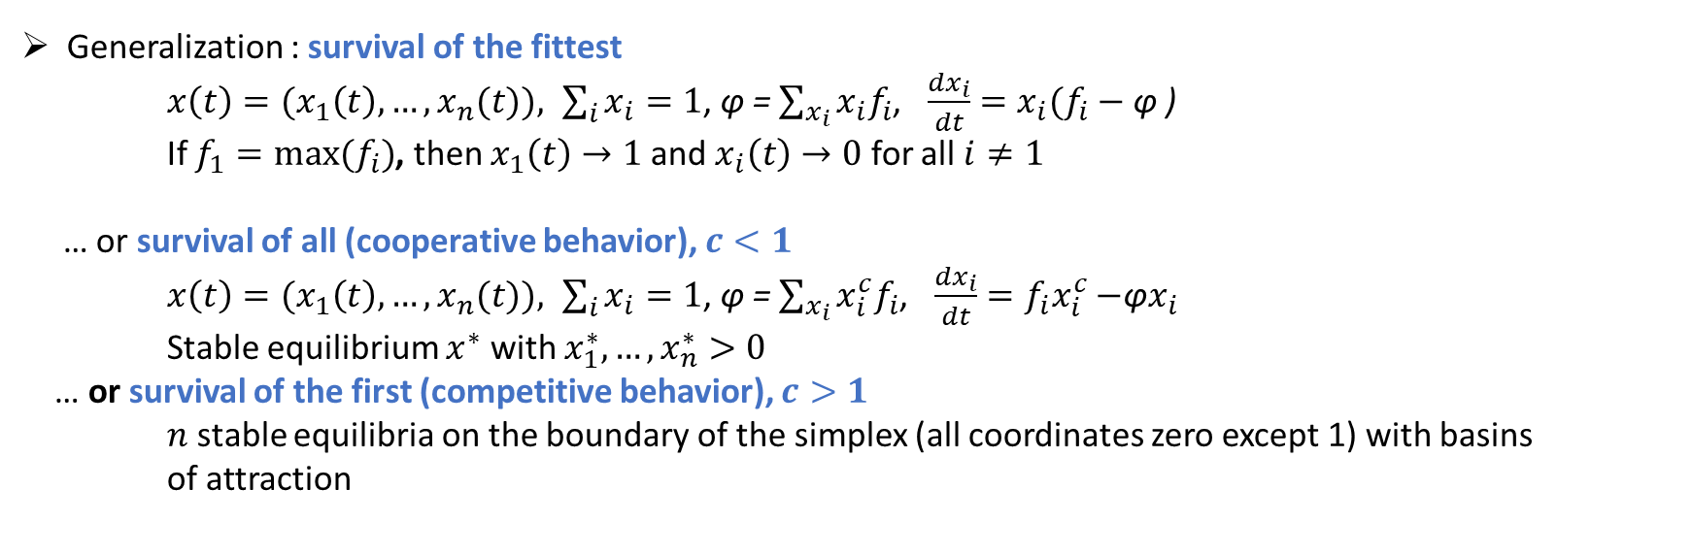
Generalization : survival of the fittest
    ${x\left(t\right)=(x}_{1}\left(t\right),…,x_{n}(t)), \sum_{i}{x_{i}=1}$, φ = $\sum_{x_{i}}{{x_{i}f}_{i}}$, $\frac{dx_{i}}{dt}=x_{i}(f_{i}−$ φ )
If $f_{1}=max⁡(f_{i})$, then $x_{1}\left(t\right)→1$ and $x_{i}\left(t\right)→0$ for all $i≠1$
… or survival of all (cooperative behavior), $c<1$
${x\left(t\right)=(x}_{1}\left(t\right),…, x_{n}(t)), \sum_{i}{x_{i}=1}$, φ = $\sum_{x_{i}}{{x_{i}^{c}f}_{i}}$, $\frac{dx_{i}}{dt}={f_{i}x}_{i}^{c}−$φ$x_{i}$
Stable equilibrium $x^{∗}$ with $x_{1}^{∗},…,x_{n}^{∗}>0$
… or survival of the first (competitive behavior), $c>1$
$n$ stable equilibria on the boundary of the simplex (all coordinates zero except 1) with basins
of attraction

Slide 14
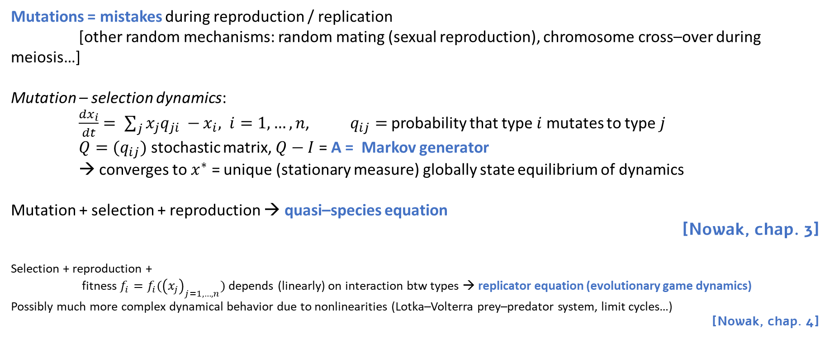
Mécanismes évolutifs. (3) Mutation
Mutations = mistakes during reproduction / replication
[other random mechanisms: random mating (sexual reproduction), chromosome cross–over during meiosis…]
Mutation – selection dynamics:
$\frac{dx_{i}}{dt}= \sum_{j}{x_{j}q_{ji} −}x_{i}, i=1,…,n$, $q_{ij}=$probability that type $i$ mutates to type $j$
$Q=(q_{ij})$ stochastic matrix, $Q−I$ = A = Markov generator
→ converges to $x^{∗}$ = unique (stationary measure) globally state equilibrium of dynamics
Mutation + selection + reproduction → quasi–species equation
[Nowak, chap. 3]
Selection + reproduction +
fitness $f_{i}=f_{i}({\left(x_{j}\right)}_{j=1,…,n})$ depends (linearly) on interaction btw types → replicator equation (evolutionary game dynamics)
Possibly much more complex dynamical behavior due to nonlinearities (Lotka–Volterra prey–predator system, limit cycles…)
[Nowak, chap. 4]

Slide 15
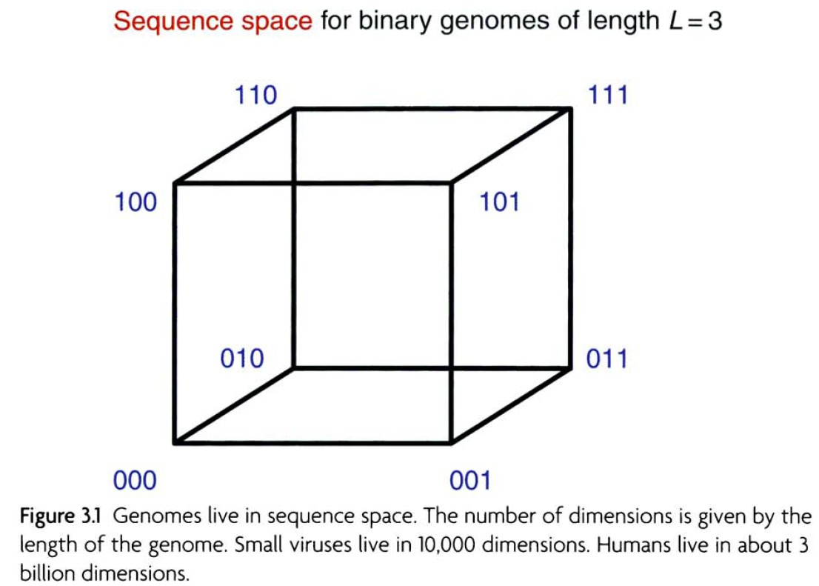
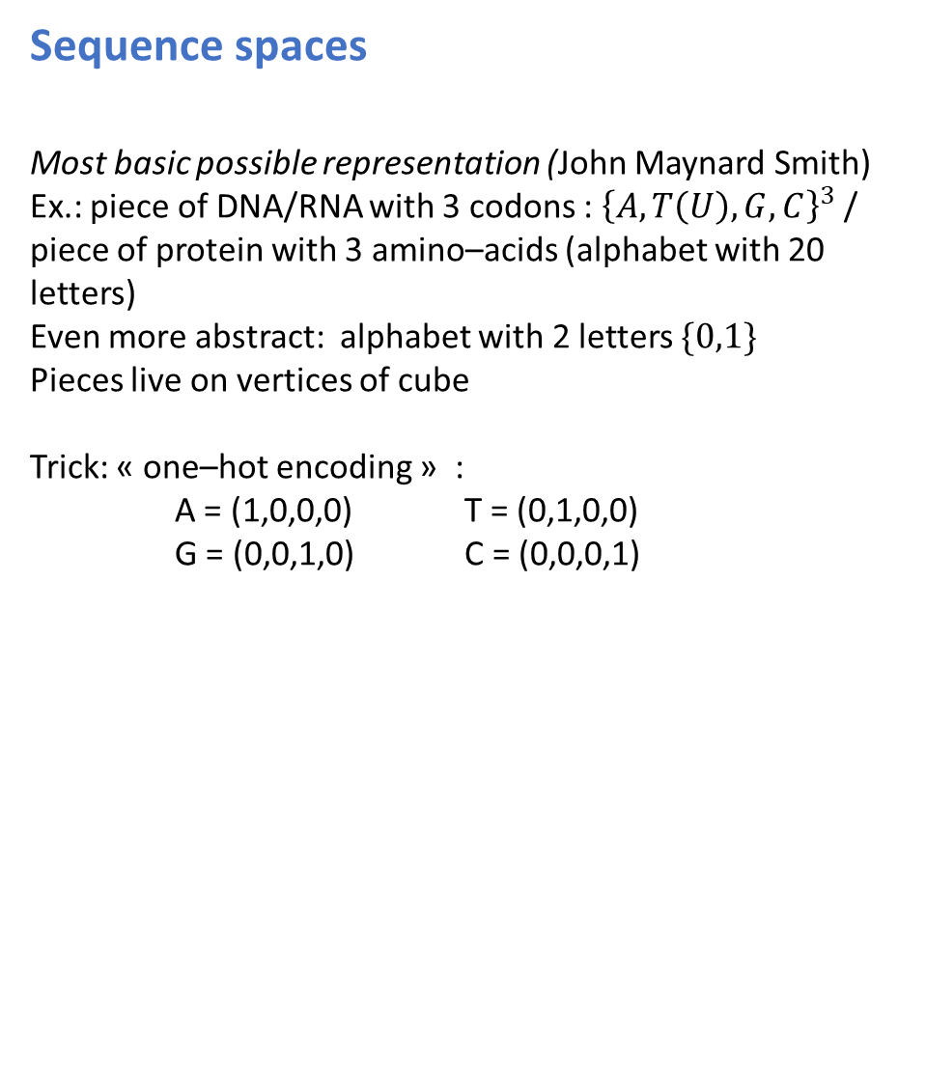
Fitness landscapes, sequence spaces, quasi–species equation
[Nowak, chap. 3]
Sequence spaces
Most basic possible representation (John Maynard Smith)
Ex.: piece of DNA/RNA with 3 codons : ${\left\{A,T\left(U\right),G,C\right\}}^{3}$ / piece of protein with 3 amino–acids (alphabet with 20 letters)
Even more abstract: alphabet with 2 letters $\{0,1\}$
Pieces live on vertices of cube
Trick: « one–hot encoding » :
A = (1,0,0,0) T = (0,1,0,0)
G = (0,0,1,0) C = (0,0,0,1)
# nucleotides in DNA/RNA

Slide 16
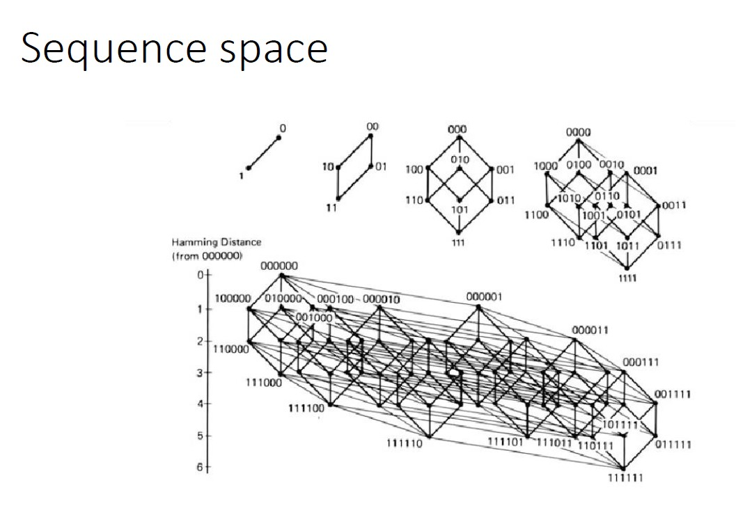

Slide 17
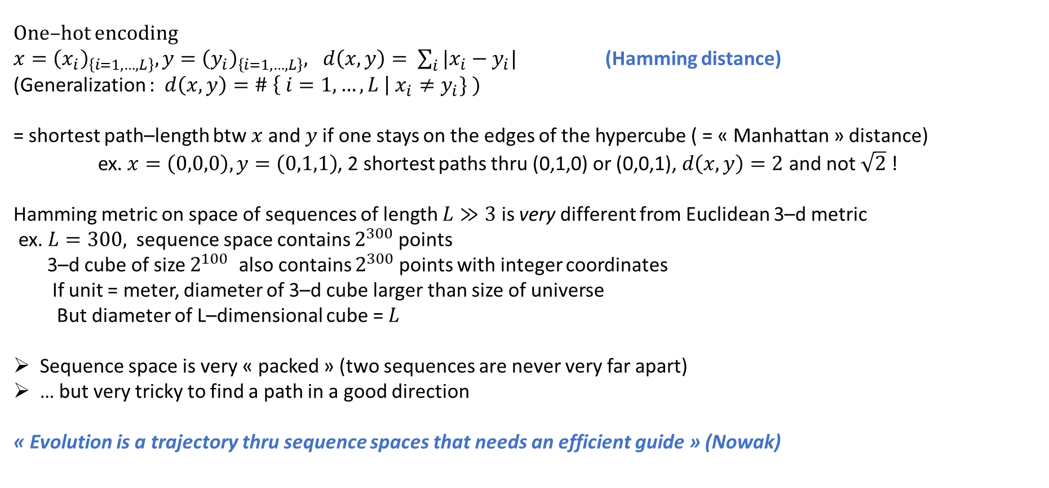
Hamming distance on sequence spaces
One–hot encoding
$x={\left(x_{i}\right)}_{\left\{i=1,…,L\right\}}, y={\left(y_{i}\right)}_{\left\{i=1,…,L\right\}}, d\left(x,y\right)= \sum_{i}{|x_{i}−y_{i}|}$ (Hamming distance)
(Generalization : $d\left(x,y\right)=\# \left\{ i=1,…,L \right| x_{i}≠y_{i}\} )$
= shortest path–length btw $x$and $y$if one stays on the edges of the hypercube ( = « Manhattan » distance)
ex. $x=\left(0,0,0\right), y=\left(0,1,1\right)$, 2 shortest paths thru (0,1,0) or (0,0,1), $d\left(x,y\right)=2$ and not $\sqrt{2}$!
Hamming metric on space of sequences of length $L≫3$ is very different from Euclidean 3–d metric
ex. $L=300,$sequence space contains $2^{300}$points
3–d cube of size $2^{100}$ also contains $2^{300}$points with integer coordinates
If unit = meter, diameter of 3–d cube larger than size of universe
But diameter of L–dimensional cube = $L$
Sequence space is very « packed » (two sequences are never very far apart)
… but very tricky to find a path in a good direction
« Evolution is a trajectory thru sequence spaces that needs an efficient guide » (Nowak)

Slide 18

Remarks.
1. Moving along an edge in sequence space is equivalent to a « single–point mutation »,
i.e. changing one letter (nucleotide/aminoacid) at a time
One–point mutations are « natural moves » (replication errors) [ + deletions, insertions, cross–overs…]
Used as an experimental method (X–rays → random one–point mutations → high–throughput screening of sequence space thru mutagenesis)
Also used as a Monte–Carlo move in inference methods
2. Sometimes « base–pair replacements » are more sensible (otherwise may change completely the structure)
change A$⋅$U pair to another pair (C$⋅G$, U$⋅$A, etc.)

Slide 19
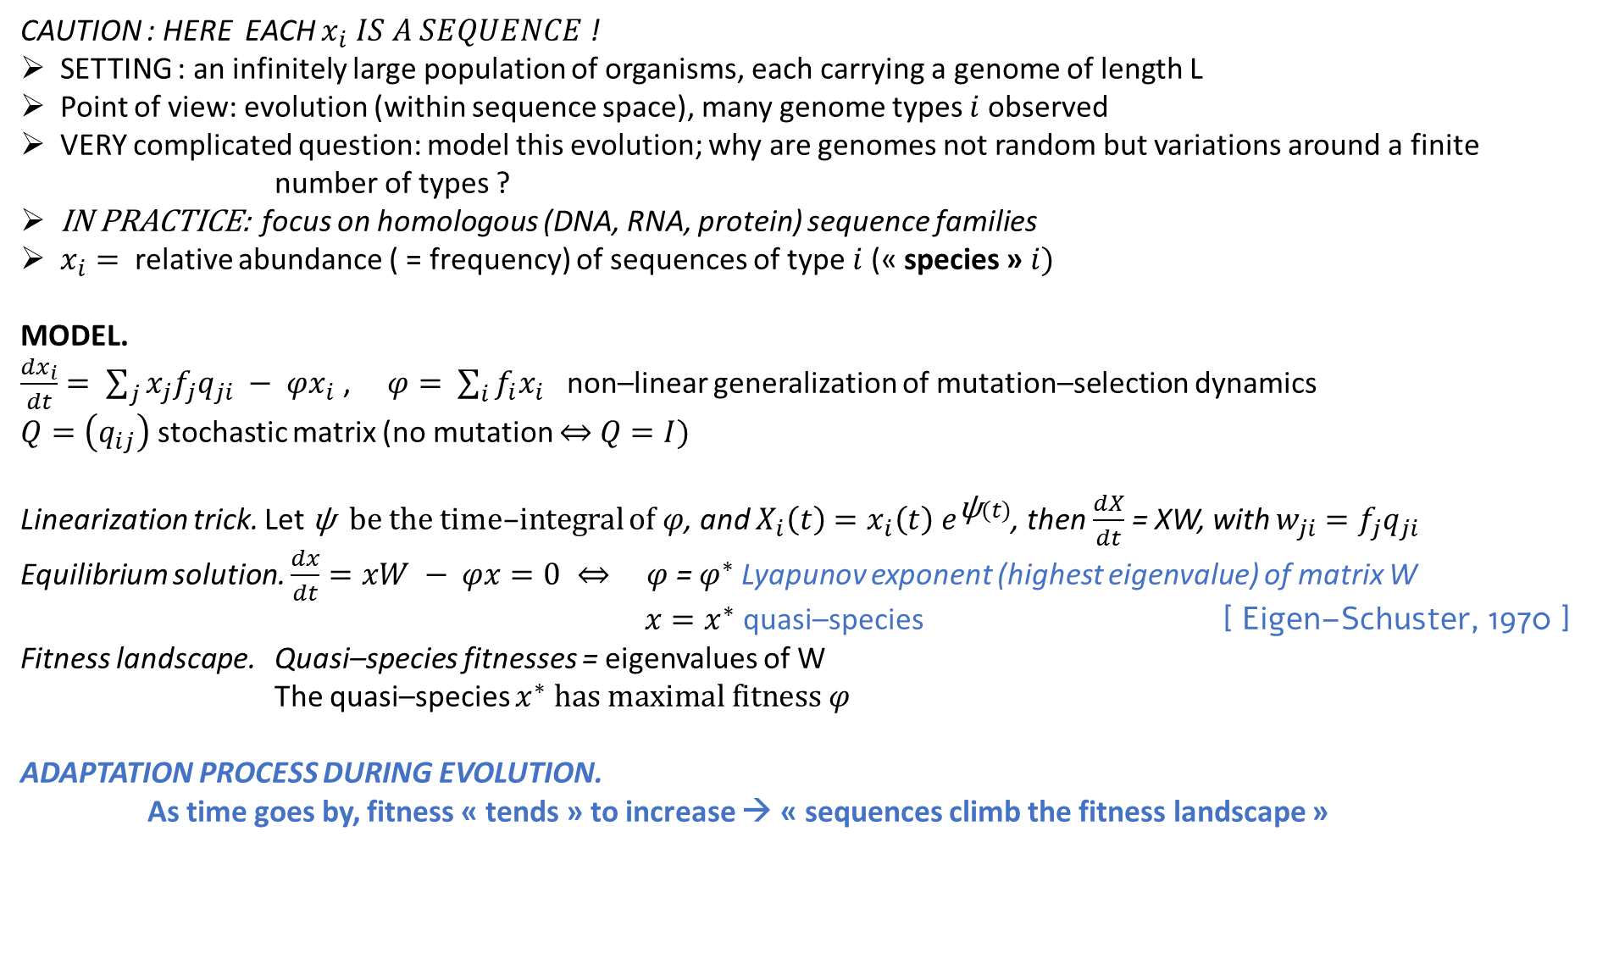
Quasi–species equation (mutation–selection + reproduction)
CAUTION : HERE EACH $x_{i} IS A SEQUENCE$ !
SETTING : an infinitely large population of organisms, each carrying a genome of length L
Point of view: evolution (within sequence space), many genome types $i$observed
VERY complicated question: model this evolution; why are genomes not random but variations around a finite
number of types ?
IN PRACTICE: focus on homologous (DNA, RNA, protein) sequence families
$x_{i}=$ relative abundance ( = frequency) of sequences of type $i$ (« species » $i)$
MODEL.
$\frac{dx_{i}}{dt}= \sum_{j}{x_{j}f_{j}q_{ji}} − φx_{i}$ , $φ= \sum_{i}{f_{i}x_{i}}$ non–linear generalization of mutation–selection dynamics
$Q=\left(q_{ij}\right)$ stochastic matrix (no mutation $⇔$ $Q=I)$
Linearization trick. Let ψ be the time–integral of $φ$, and $X_{i}\left(t\right)=x_{i}\left(t\right){ e}^{\text{ψ}(t)}$, then $\frac{dX}{dt}$ = XW, with $w_{ji}=f_{j}q_{ji}$
Equilibrium solution. $\frac{dx}{dt}=xW − φx=0 ⇔ φ$ = $φ^{∗}$Lyapunov exponent (highest eigenvalue) of matrix W
$x=x^{∗}$ quasi–species [ Eigen–Schuster, 1970 ]
Fitness landscape. Quasi–species fitnesses = eigenvalues of W
The quasi–species $x^{∗} has maximal fitness φ$
ADAPTATION PROCESS DURING EVOLUTION.
As time goes by, fitness « tends » to increase → « sequences climb the fitness landscape »

Slide 20
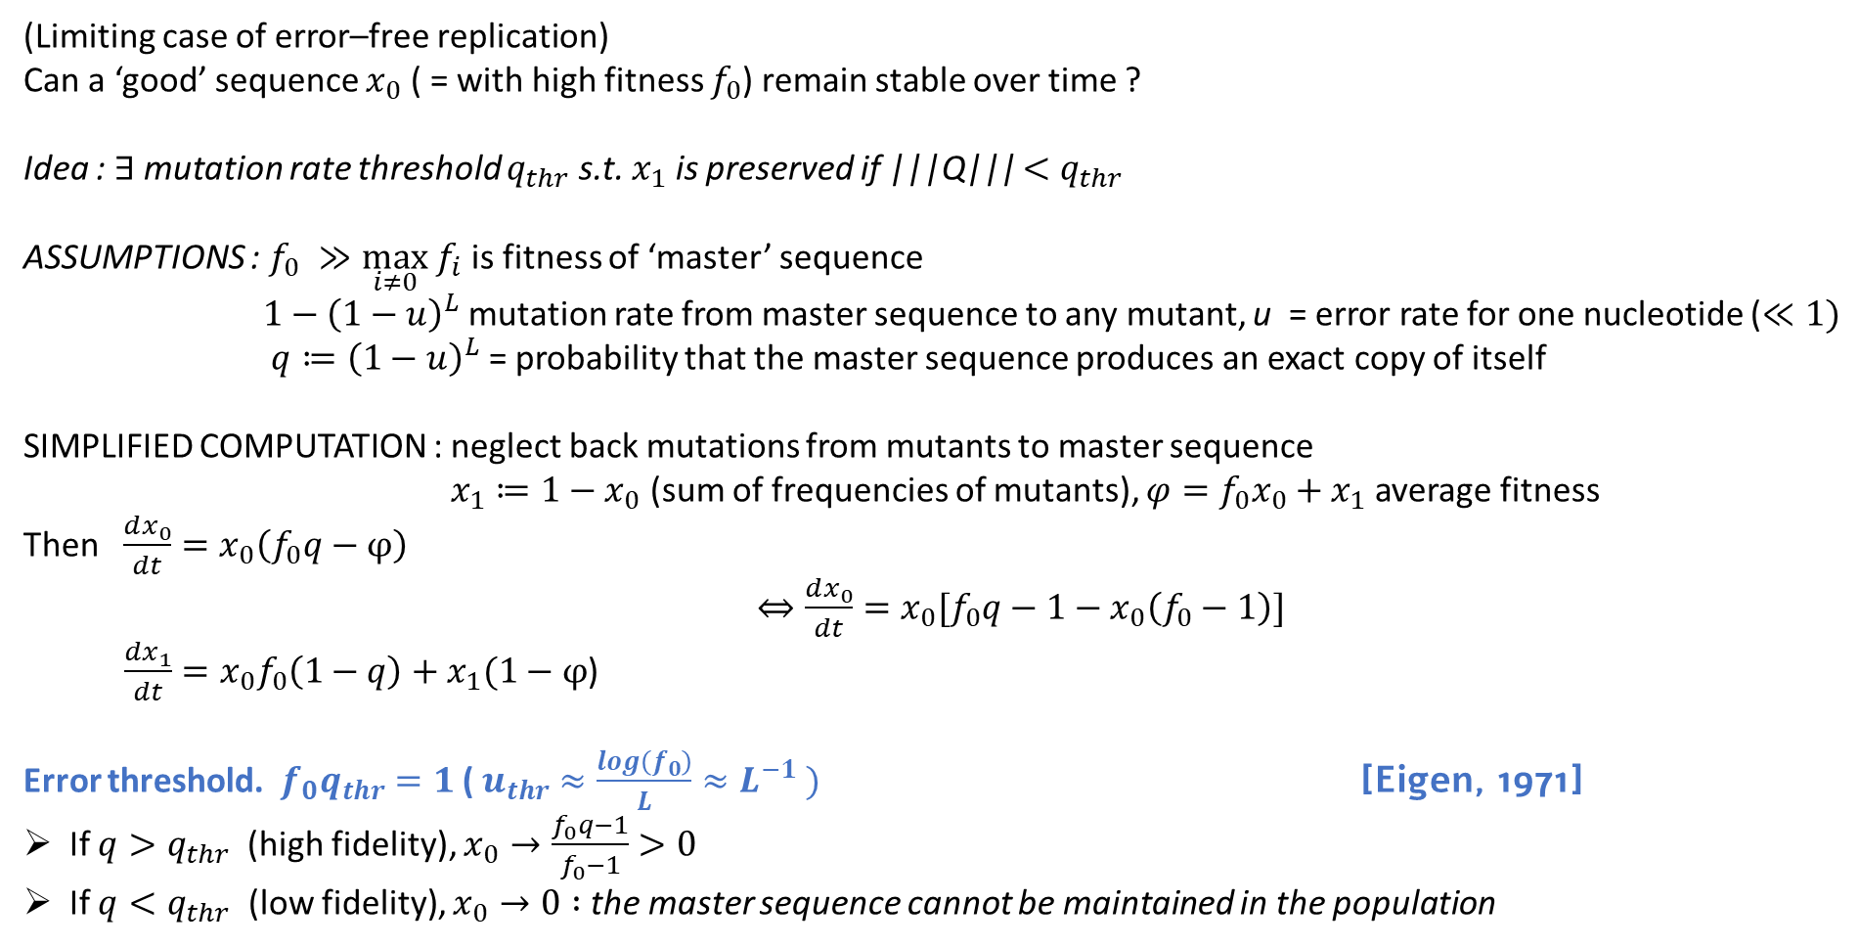
Perturbation of (selection + reproduction) by mutation – Error threshold
(Limiting case of error–free replication)
Can a ‘good’ sequence $x_{0}$ ( = with high fitness $f_{0}$) remain stable over time ?
Idea : $∃$mutation rate threshold $q_{thr}$ s.t. $x_{1}$ is preserved if |||Q||| $<q_{thr}$
ASSUMPTIONS : $f_{0} ≫\max_{i≠0} f_{i}$ is fitness of ‘master’ sequence
$1−{\left(1−u\right)}^{L}$ mutation rate from master sequence to any mutant, u = error rate for one nucleotide ($≪1)$
$q≔{\left(1−u\right)}^{L}$ = probability that the master sequence produces an exact copy of itself
SIMPLIFIED COMPUTATION : neglect back mutations from mutants to master sequence
$x_{1}≔1−x_{0}$ (sum of frequencies of mutants), $φ=f_{0}x_{0}+x_{1}$average fitness
Then $\frac{dx_{0}}{dt}=x_{0}\left(f_{0}q−φ\right)$
$⇔\frac{dx_{0}}{dt}=x_{0}[f_{0}q−1−x_{0}\left(f_{0}−1\right)]$
$\frac{dx_{1}}{dt}=x_{0}f_{0}\left(1−q\right)+x_{1}(1−φ$)
Error threshold. $f_{0}q_{thr}=1$ ( $u_{thr}≈\frac{log\left(f_{0}\right)}{L}≈L^{−1} )$ [Eigen, 1971]
If $q>q_{thr}$(high fidelity), $x_{0}→\frac{f_{0}q−1}{f_{0}−1}>0$
If $q<q_{thr}$ (low fidelity), $x_{0}→0 :$the master sequence cannot be maintained in the population

Slide 21
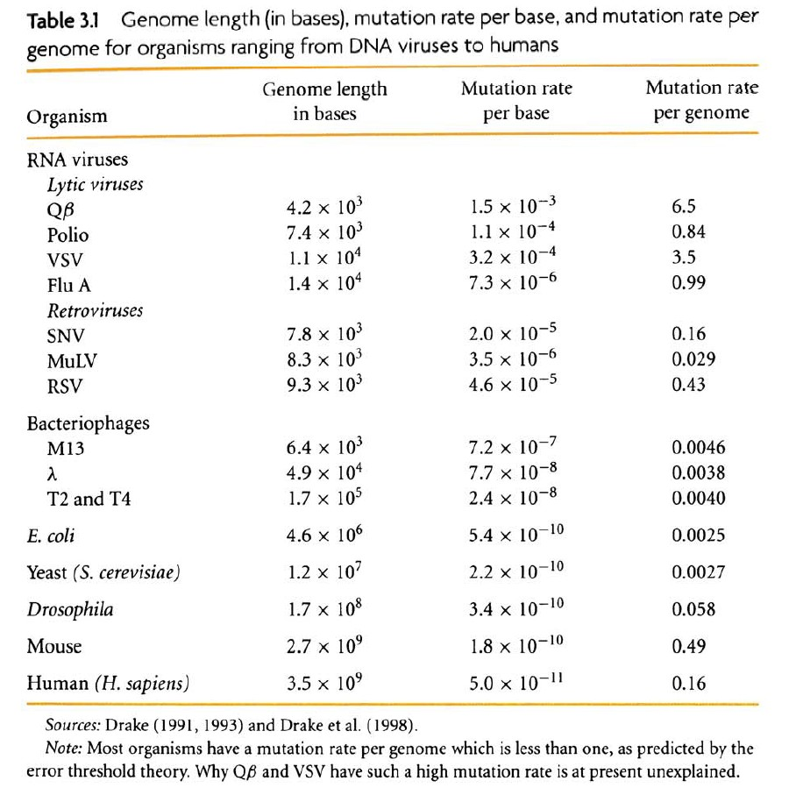
[Nowak, chap. 3]

Slide 22
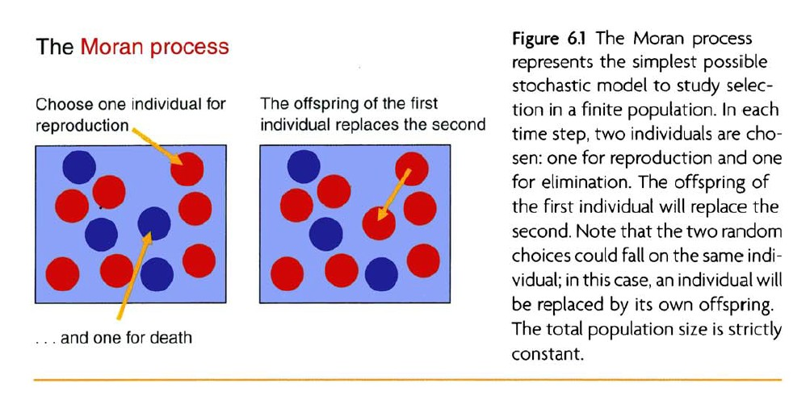
Random drift, molecular clock of neutral evolution
Key idea: forget about fitnesss differences & mutations : random drift is the rule for finite samples and is enough to produce selection
Standard model : Fisher–Wright model (random pooling, conservation of total population) –– exposé ou TD
Simplified model due to P. A. P. Moran (Moran process, 1958) [Nowak, chap. 6]

Slide 23
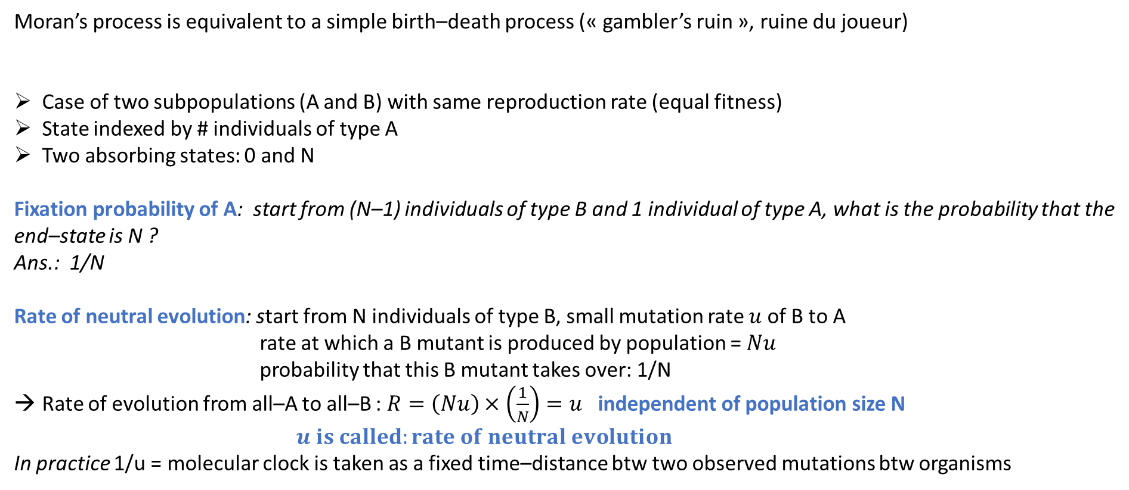
Moran’s process is equivalent to a simple birth–death process (« gambler’s ruin », ruine du joueur)
Case of two subpopulations (A and B) with same reproduction rate (equal fitness)
State indexed by # individuals of type A
Two absorbing states: 0 and N
Fixation probability of A: start from (N–1) individuals of type B and 1 individual of type A, what is the probability that the
end–state is N ?
Ans.: 1/N
Rate of neutral evolution: start from N individuals of type B, small mutation rate $u$of B to A
rate at which a B mutant is produced by population = $Nu$
probability that this B mutant takes over: 1/N
Rate of evolution from all–A to all–B : $R=\left(Nu\right)×\left(\frac{1}{N}\right)=u$ independent of population size N
$u is called:rate of neutral evolution$
In practice 1/u = molecular clock is taken as a fixed time–distance btw two observed mutations btw organisms

Slide 24
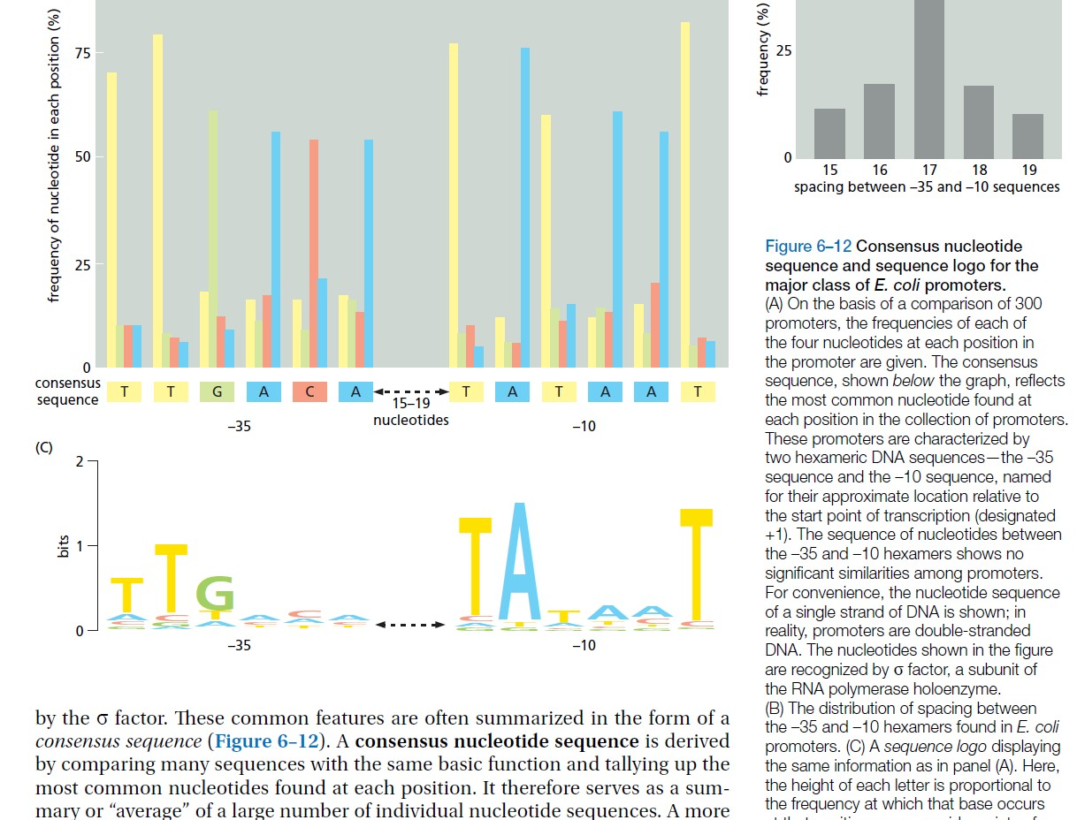
What do sequence families look like ?

Slide 25
One example of multiple sequence alignment (MSA), case of RNA (from Lambert, Opuu et al., group I introns)
(817 sequences with L=193, 1st sequence = Azo = azoarcus group I intron)
CCUUGCGCCGGGAAACCACGCAAGGGAUGGUGUCAAAUUCGGCGAAACCUAAGCGCCCGCCCGGGCGUAUGGCAACGCCGAGCCAAGCUUCGGCGCCUGCGCCGAUGAAGGUGUAGAGACUAGACGGCACCCACCUAAGGCAAACGCUAUGGUGAAGGCAUAGUCCAGGGAGUGGCGAAAGUCACACAAACCG
––––GCA–––G––––CUGUGUAAGGGAUGGUGUCAAAUUCGAUGAAACCUAAGUGUG–G–CAACACAUAUGGCAAUGUCGAGCGAAGCUUAGUGCGAAAGCACUUUGAACGUGUAGAGACUUGACGGCACCCACCUAAGUACA––UAUAUGGUGAAGGCAAAGUCCAGCGAGUGAUGAAAGUCACAC––––––
––––––GC–AG––––CUGCAUAAGGGAUGGUGUCAAAUUCGGAGAAAGCUAAAUGUAGCC––CUGCACAAGCUAACGCCGAGCCAAGCUUCAGCGUAAGUGCUGUUGAAGGUGUAGAGACUAGACGGCACCCAUCUAAGUCAAUCGAUAUGAUGAAGGCAUAGUCCAGGGAGUAGUGAAAGCUACAC––––––
––––GCA–––G––––CUGUGUAAGGGAUGGUGUCAAAUUCGAUGAAACCUAAGUGUG–G–CAACACAUACGGCAAUGUCGAGCGAAGCUUAGUGCGAAAGCACUUUGAACGUGUAGAGACUUGACGGCACCCACCUAAGUACA––UAUAUGGUGAAGGCAAAGUCCAGCGAGUGAUGAAAGUCACAC––––––
––––––GC–AG––––CUGCAUAAGGGAUGGUGUCAAAUUCGGAGAAAGCUAAAGGUA–GAAA–UAUCUAAGCUAACGCCGAGCGAAGCUUAGUAAGAAAUUACUUUGAACGUGUAGAGACUAGACGGCACCCACCUAAGUUAAAUAAUACGGUGAAGGCAUAGUCCAGGGAGUAAUGAAAAUUACAC––––––
––––GCA–––G––––CUGUGUAAGGGAUGGUGUCAAAUUCGGAGAAACCUAAA––––––––––––––UAUGGCAACGCCGAGCGAAGCUUCAAUGCAAGUAUUGUUGAACGUGUAGAGACUAGACGGCACCCAUCUAAGUUC–––AAUAUGAUGAAGGCAUAGUCCAGGGAGUAGUGAAAGCUACAC––––––
––––––G–––––––––––CGU–GUGAAUGUAGUCAAAUUCGGUGAAACCUAACAAGUGU–UGUACUUUAAGGCAAUACCGAGCCAAGCCCUG–––UCUA–––CAGGGAAGGUGUAGAGACUAGACGGCUACCACCUAAAG––––––CAACGGUGAAGGUAUAGUCCAGAGAGUGAGGAAACUCACAC––––––
–––––––GC––––––––CAUGAGUGAAUGUGGUCAAAUUCGGUGAAACCUAAAGAGUGAC––CACCCUACGGCAAUACCGAGCCAAGCCUGA––––––––––UCAGGAAGGUCUAGAGACUAGACGGCCACCACCUAAAGGAAUCCCUAUGGUGAAGGUAUAGUCCAGAGAGUGGGGAAACUCACAC––––––
––––––––––G––––UCUGGGAGUGAAUGUGGUCAAAUUUGGUGAAACCUAAAGAGUU––––GACUCUAAGGCAAUACCAAGCCAAGCCUGA––––––––––UCAGGAAGGUUUAGAGACUAGACGGUCACCACCUAAAAG––––CCUAUGGUGAAGGUAUAGUCCAGAGAGUGGGGAAACUCACAC––––––
––––––GC––––––––––––GUGUGAAUGUGGUCAAACUCAAGGAAGCCUAAGUUCUG–––UUAGGAUAAGGUAAUCUUGAGCCAAGCUUUAUCUCA––AGAUAAAGAAGGUGCAGAGACUCAACGGCCACCGCCUAA––––––––––AUGGUGAAGAAAGAGUCCAGAGAGUGGGGAAACUCACAC––––––
etc.

Slide 26
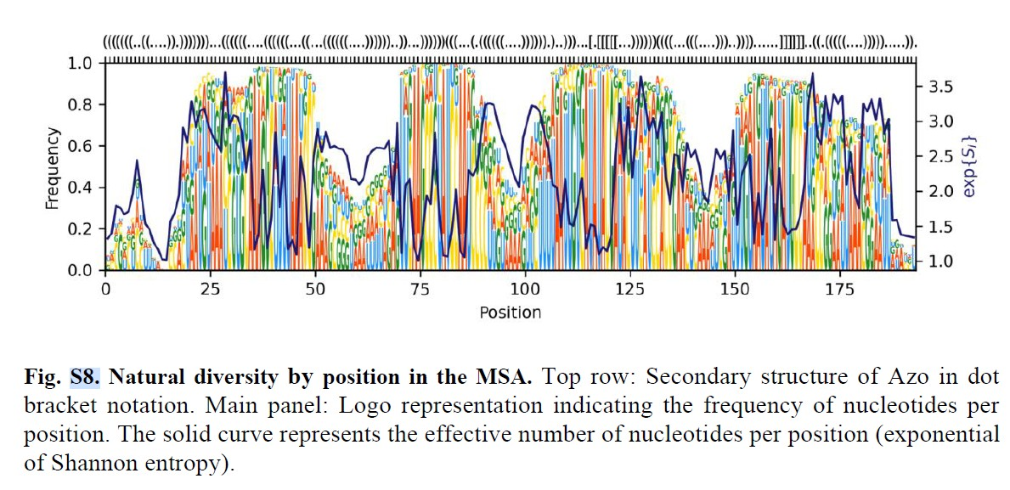
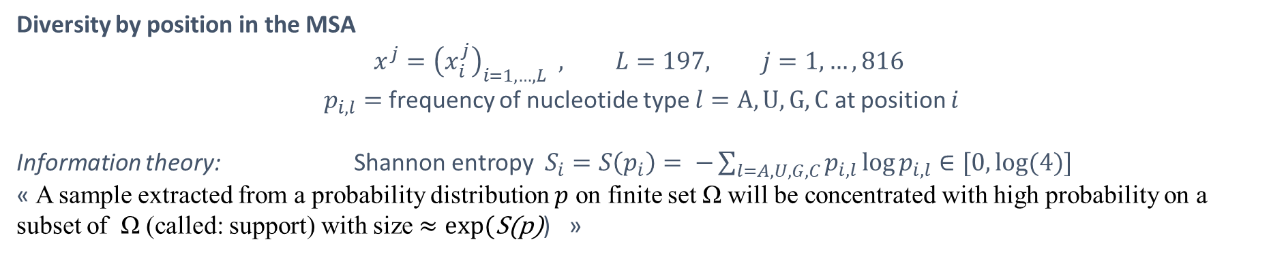
Diversity by position in the MSA
$$x^{j}={\left(x_{i}^{j}\right)}_{i=1,…,L} , L=197, j=1,…,816$$
$p_{i,l}=$frequency of nucleotide type $l=A,U,G,C$ at position $i$
Information theory: Shannon entropy $S_{i}=S\left(p_{i}\right)= −\sum_{l=A,U,G,C}{p_{i,l}\log{p_{i,l}}}∈[0,log⁡(4)]$
« A sample extracted from a probability distribution $p$ on finite set Ω will be concentrated with high probability on a subset of Ω (called: support) with size $≈exp⁡(\text{S}\text{(}\text{p}\text{)}$) »

Slide 27
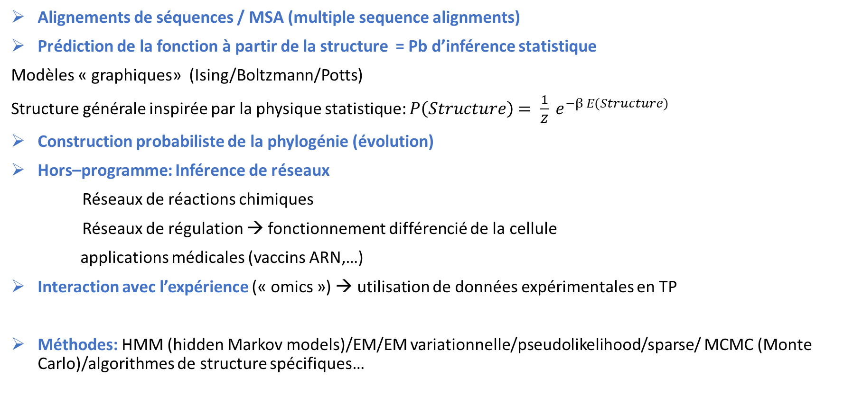
Questions de fond
Alignements de séquences / MSA (multiple sequence alignments)
Prédiction de la fonction à partir de la structure = Pb d’inférence statistique
Modèles « graphiques» (Ising/Boltzmann/Potts)
Structure générale inspirée par la physique statistique: $P\left(Structure\right)$ $= \frac{1}{Z} e^{−β E(Structure)}$
Construction probabiliste de la phylogénie (évolution)
Hors–programme: Inférence de réseaux
Réseaux de réactions chimiques
Réseaux de régulation → fonctionnement différencié de la cellule
applications médicales (vaccins ARN,…)
Interaction avec l’expérience (« omics ») → utilisation de données expérimentales en TP
Méthodes: HMM (hidden Markov models)/EM/EM variationnelle/pseudolikelihood/sparse/ MCMC (Monte Carlo)/algorithmes de structure spécifiques…

Slide 28
Formations spécialisées, laboratoires
Master spécialité Bioinformatique, Sorbonne Université
https://www.lcqb.upmc.fr/BIM/
Parcours BioInformatique et Modélisation (BIM) offert conjointement par:
        le Master d’Informatique (resp.: A. Carbone, M. Weigt)
        le Master de Biologie Moléculaire et Cellulaire (resp. M2: I. Lafontaine)
Laboratoires
        AMIB(IO), Algorithms & models for Integrative Biology (S. Will, Y. Ponty) https://www.lix.polytechnique.fr/amibio/index.php/publications/
        LCQB, Laboratory of Computational & Quantitative Biology (M. Weigt, A. Carbone)
            https://www.lcqb.upmc.fr/AnalGenom/projects.html
        IPGG, Institut Pierre-Gilles de Gennes, ESPCI (Ecole Sup. de Phys. & Chimie industrielles), équipe Biophysique & évolution du laboratoire Chimie biologie innovation (directeur: P. Nghe)

Slide 29
Masters sur des thématiques voisines (Paris)
Master MVA, cours de R. Cazals, Algorithms and learning for protein sciences (méthodes statistiques/ML pour les polymères informationnels, + MD),
  https://www.master-mva.com/cours/algorithms-and-learning-for-protein-science/
et cours de biostats de R. Porcher, https://www.master-mva.com/cours/biostatistics/
(orienté recherche clinique/médicale)
M2 Maths Sorbonne/X/ENPC (Ponts & Chaussées), Parcours Mathématiques de la Modélisation, Majeure applications biologie / médecine, L. N. de Almeida (contrôle optimal / éq. RD), M. Thieullen (neurosciences)
Master MSV (Maths pour les Sciences du Vivant), groupe Telecom, cours de biostats de R. Porcher / dynamiques des populations/épidémiologie/neurosciences
A Nancy
Nancy Computational Structural Biology (NCSB) Meeting: sur un jour, en juin chaque année (LORIA)

Slide 30
Débouchés
Thèse orientée ML en co–direction avec laboratoire de biologie (ESPCI, Paris;…)
Offres de postes ingénieur recherche/thèse en maths–bio–santé:
      https://math–bio–sante.math.cnrs.fr/emploi.html
Biotechnologies, grands groupes anglo–saxons et suisses / start–ups Fr (…)
Références (extraits)
Molecular biology of the cell (6th ed.), Alberts, Morgan et al., Garland Science (intro. to biology)
Biological sequence analysis. Probab. Models of proteins & nucleic acids, Durbin, Eddy, Krogh, Mitchison, Cambridge Univ. Press, 1998 (reference book).
From statistical physics to data–driven modelling, with applications to quantitative biology, Cocco, Monasson, Zamponi, Oxford Univ. Press, 2022 (tutorial based on course given at ENS 2017-2021 ).
M. Zuker, P. Ziegler. Optimal computer folding of large RNA sequences using thermodynamics and auxiliary information, classical article, Nucleic Acids Research (1981).
C. Lambert, V. Opuu et al. Expanding the space of self–reproducing ribozymes using probabilistic generative models, research article (preprint 2024).

